Slide 1
The World Happiness Report
TEAM 2
BENJAMIN COTTAM, DARRELL NELSON & MELLISSA NGUON
Notes:
Team Introductions

Slide 2
Agenda
Executive Summary
Research Objective, Plan and Methodology
Data Findings
Conclusion / Recommendations
Notes:
Agenda

Slide 3
Background & Overview: The World Happiness Report is a landmark survey of the state of global happiness that ranks 156 countries by how happy their citizens perceive themselves to be. This survey was conducted using the Cantril ladder by asking respondents to think of a ladder, with the best possible life for them being a 10, and the worst possible life being a 0, and then were asked to rate their own current lives on that 0 to 10 scale. Situation: We believe there are specific customer segments, who would be interested in traveling to the happiest countries in the world. Based on this analysis, we will recommend the top happiest countries that will be popular routes / destinations for the travel and tourism industry. Proposal: To conduct an analysis on the following questions: - What are the top three parameters in predicting a country’s happiness score? - Which continent is the most/least happy? - Which countries have improved the most in those areas from 2015-2017? - Which countries have fallen the most in those areas from 2015-2017?
Executive Summary

Slide 4
Research Objective: To identify and analyze predictors correlated to the happiness score Research Plan: Use 3 different types of analyses (K-means clustering, Neural network classification, Random forest Decision Tree), retrieve raw data from Kaggle Research Methodology: Employ a variety of different methods and determine which ones are the best to answer our market research questions
Research Objective, Plan and Methodology

Slide 5

Data Findings

Slide 6
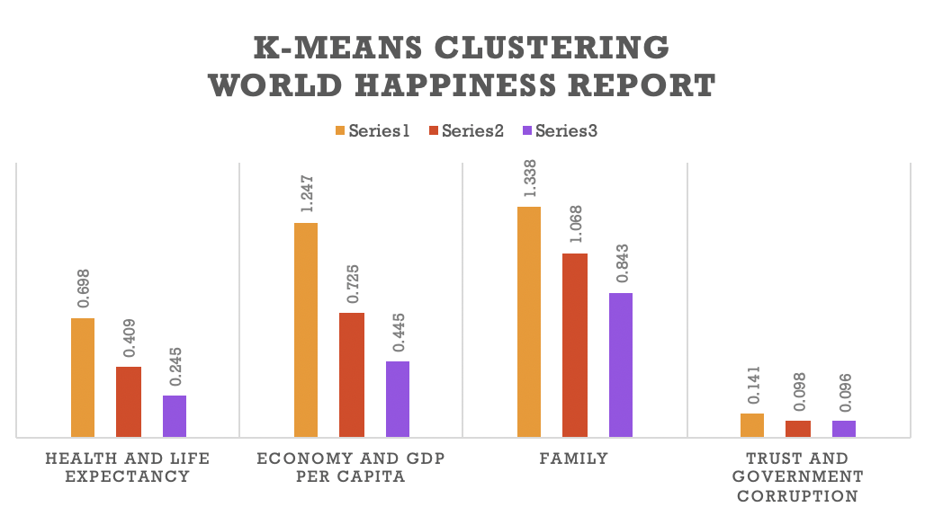

Slide 7
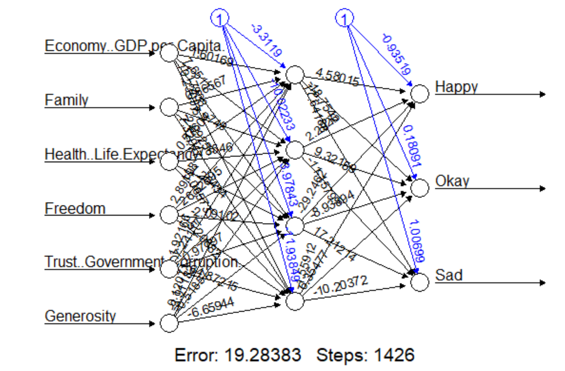
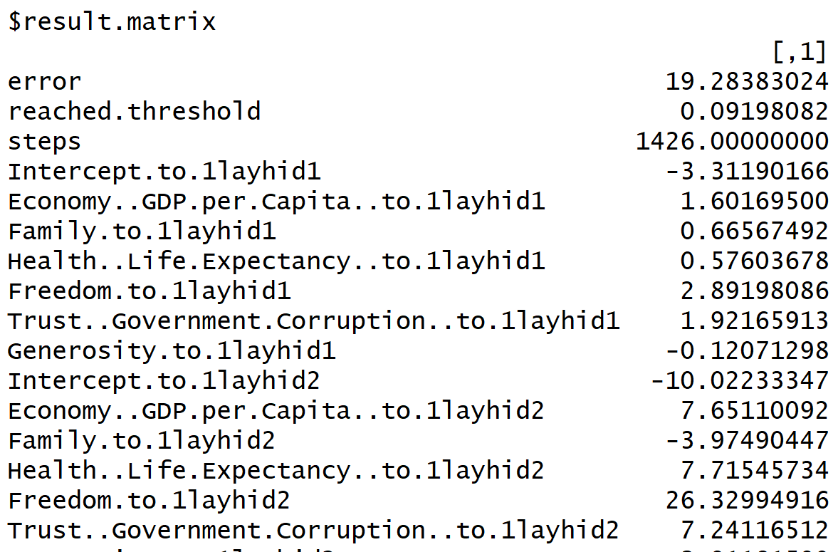
Neural Network Analysis
Machine Learning algorithm that utilizes the logistic regression to represent nonlinear behavior
Best suited for classification problems
Model used all input data to predict groupings for each country
Coefficients of NN:

Slide 8
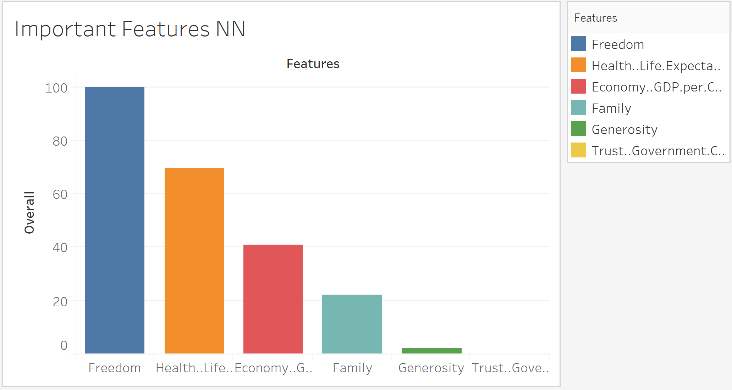
Neural Network: Important Features
Which attribute has the strongest affect on the happiness score
Run Sensitivity Analysis and Normalize Results
Top 3 parameters:
Freedom
Health
Economy

Slide 9
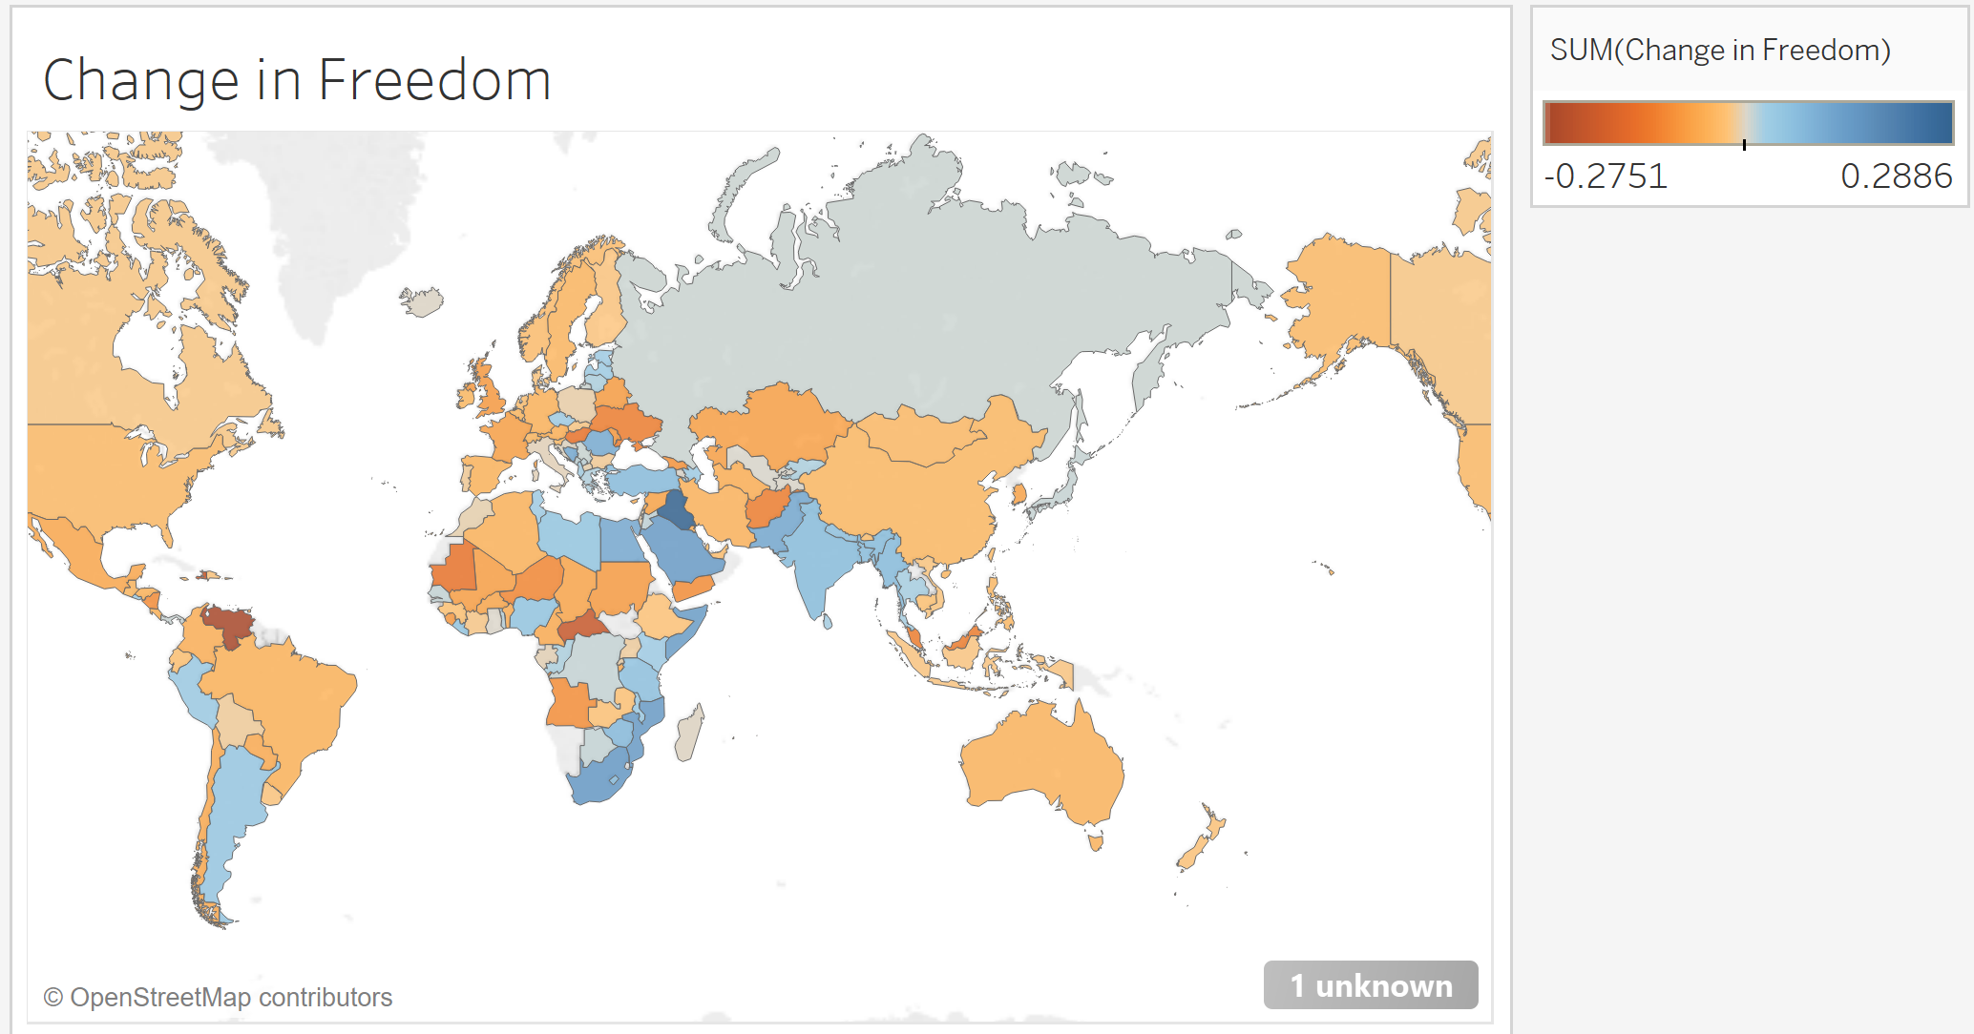
High Achievers:
Iraq
South Africa
Mozambique
Worst Regressors:
Venezuela
Central Africa
Haiti

Slide 10
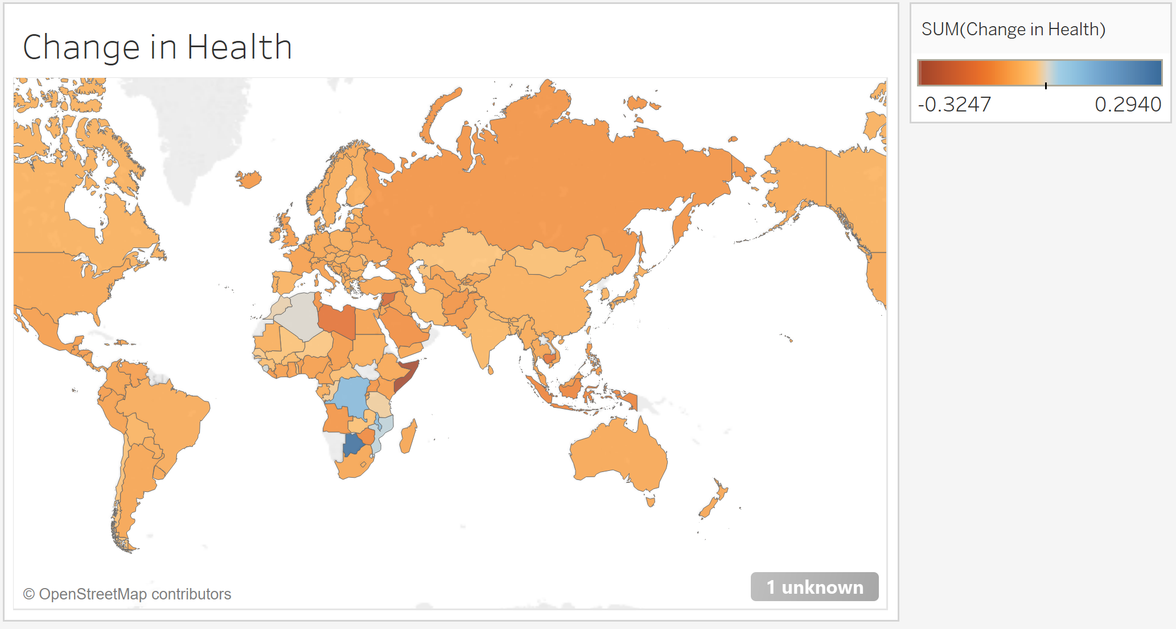
High Achievers:
Botswana
Congo
Malawi
Worst Regressors:
Somalia
Syria
Libya

Slide 11
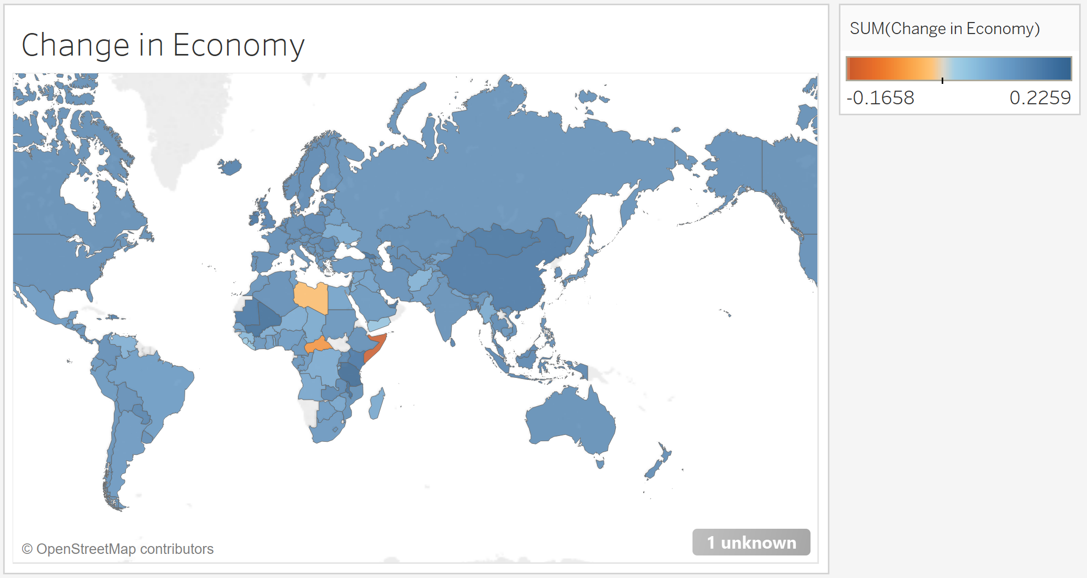
High Achievers:
Tanzania
Malawi
Mali
Worst Regressors:
Somalia
Central African Republic
Libya

Slide 12
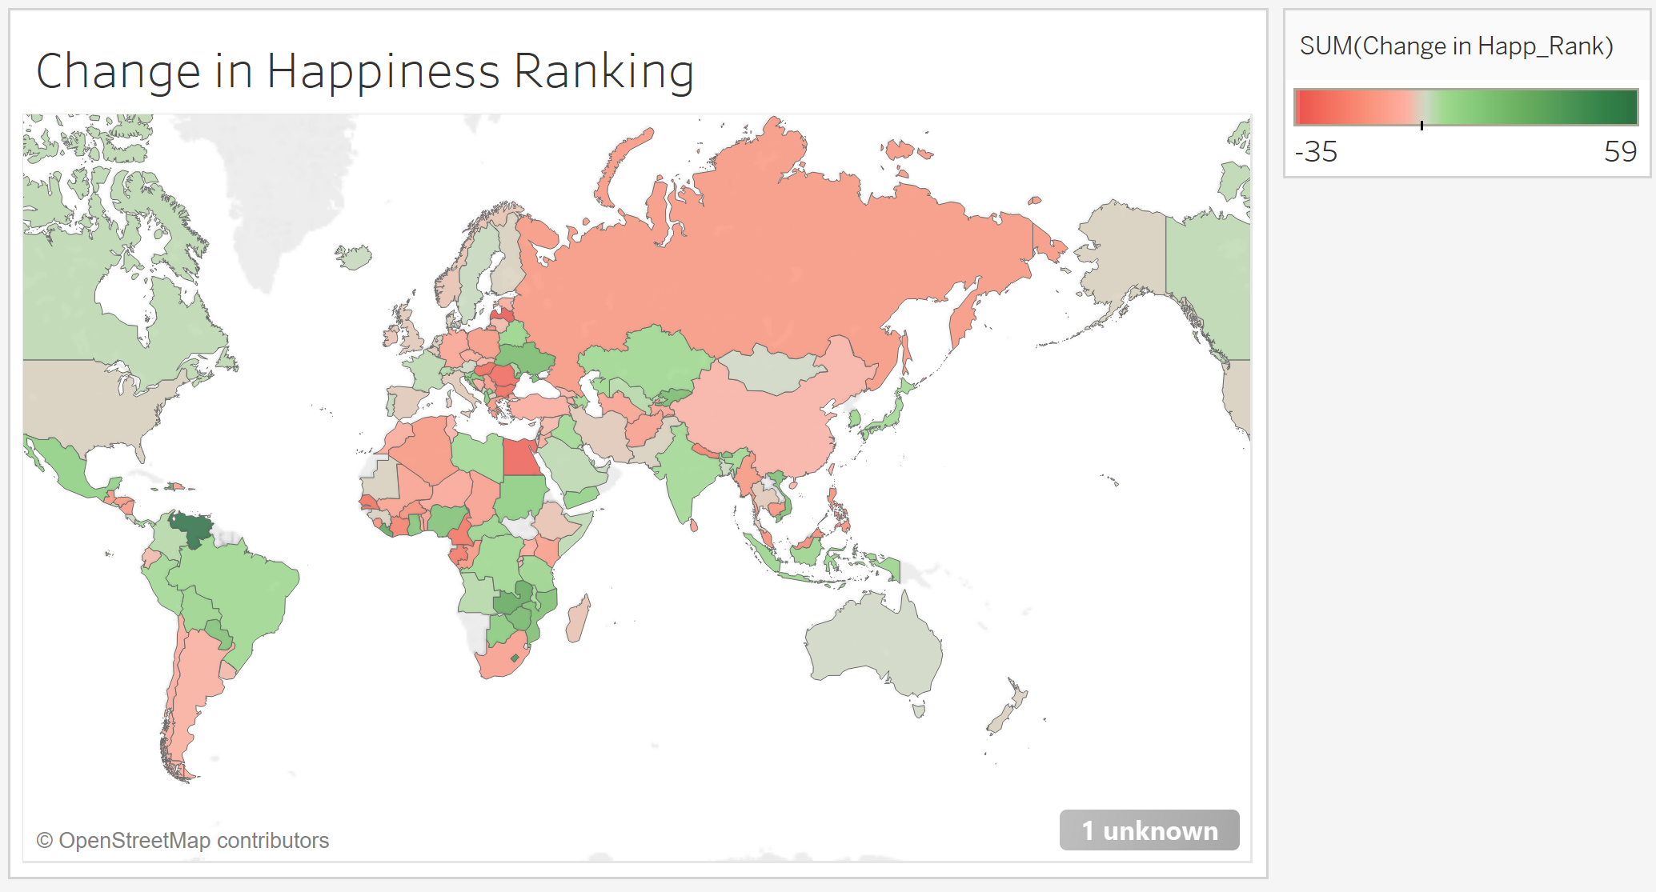
High Achievers:
Venezuela
Lesotho
Liberia
Worst Regressors:
Latvia
Egypt
Romania

Slide 13
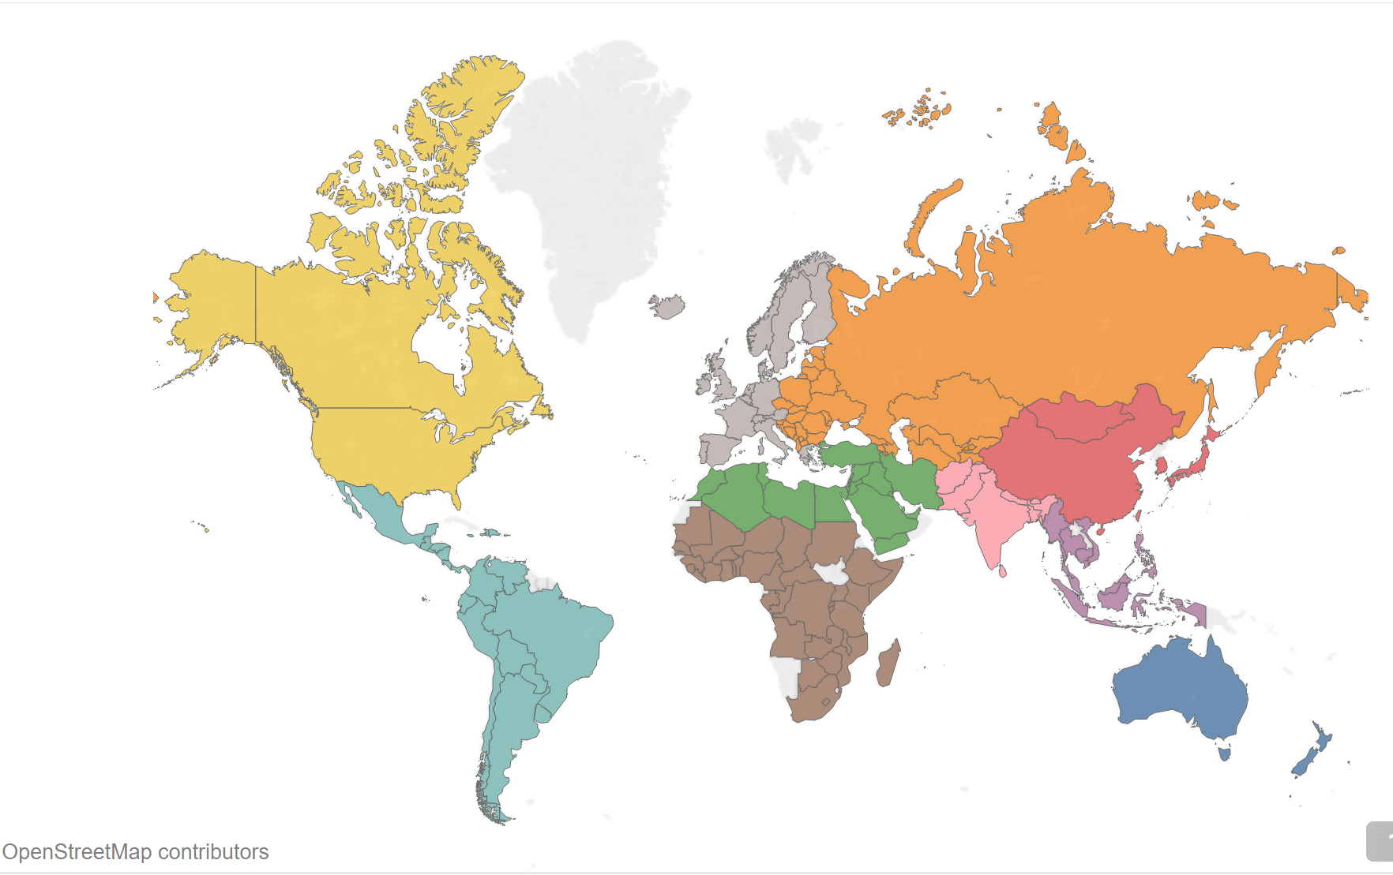
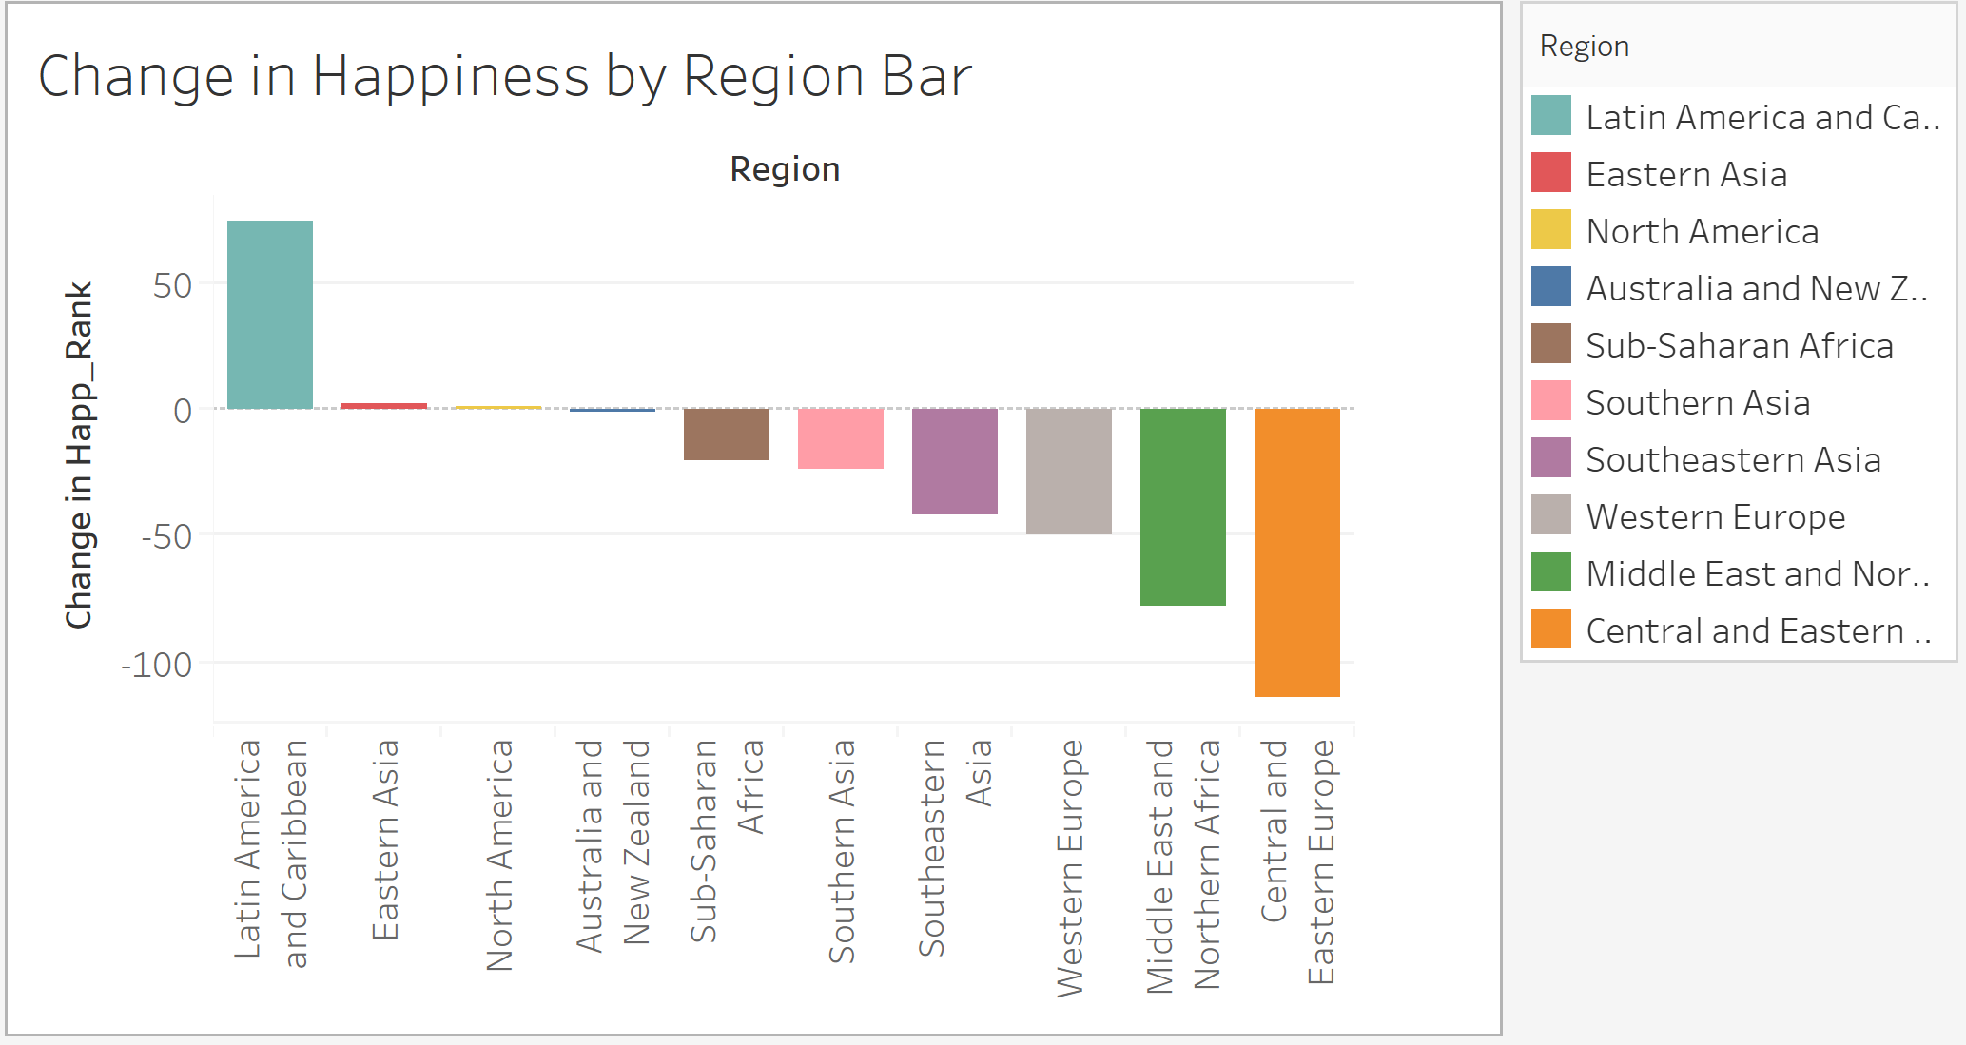
Happiness by Region

Slide 14
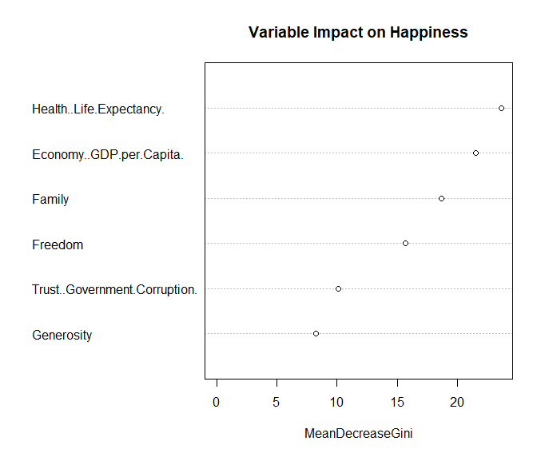
Random Forest Decision Tree Model

Slide 15
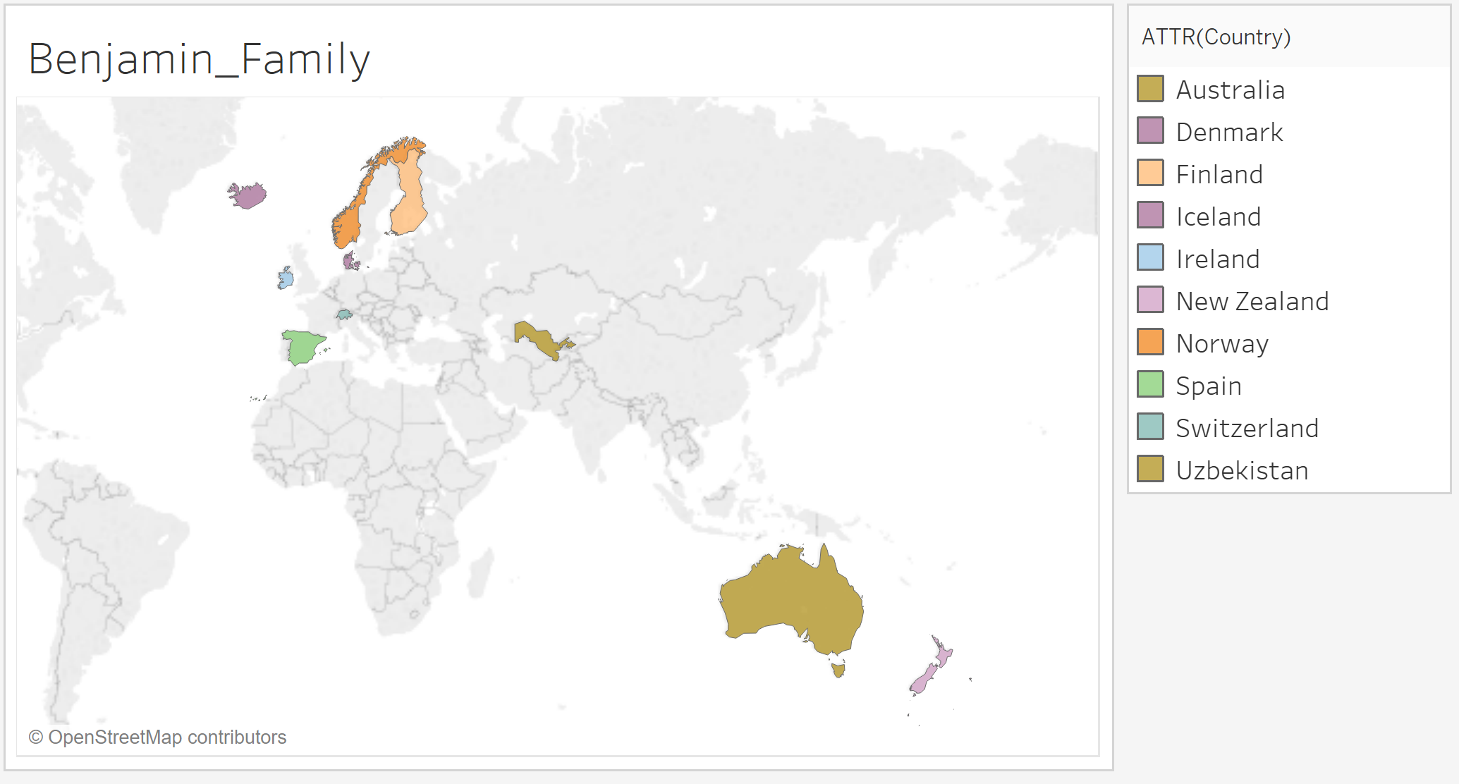
Countries With Highest Family Importance

Slide 16
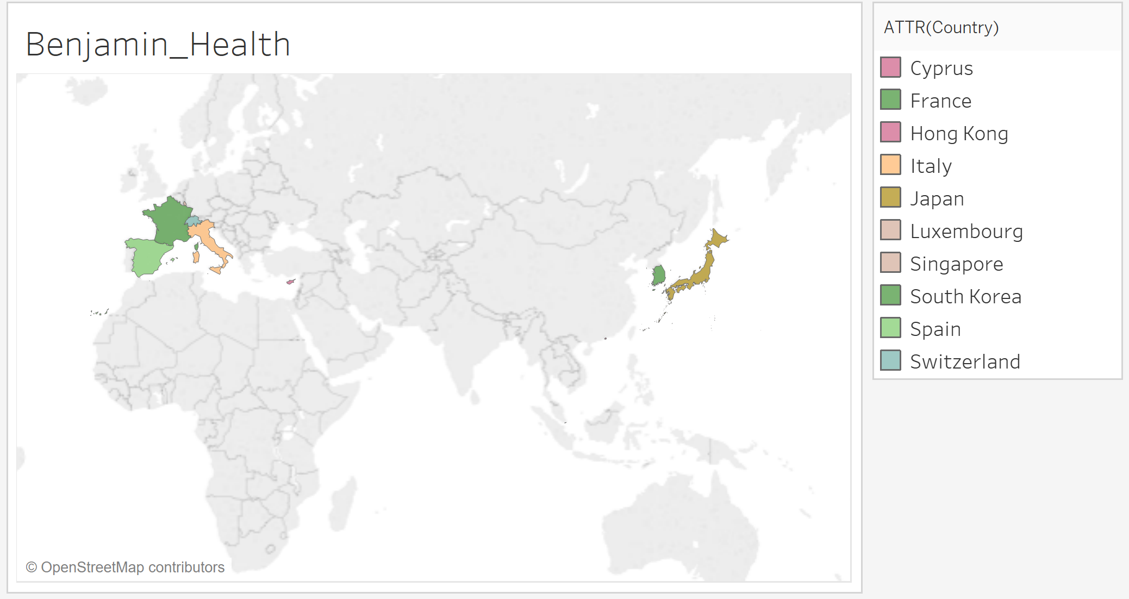
Countries With Highest Health Importance

Slide 17
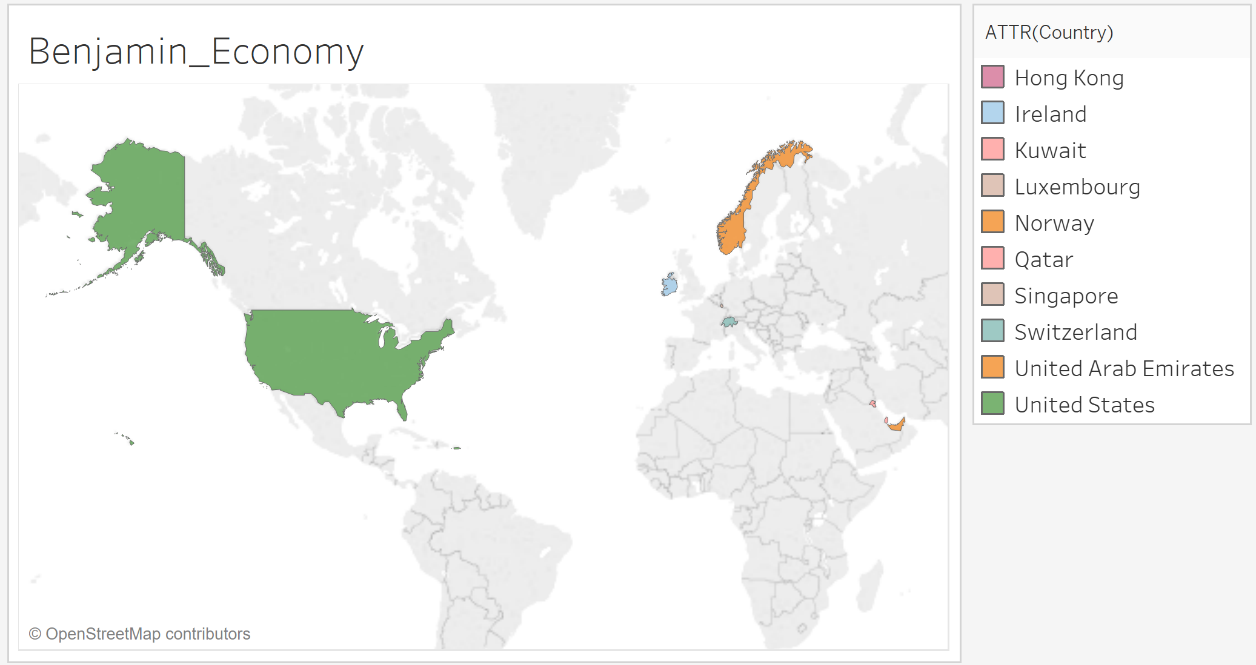
Countries With Highest Economy Importance

Slide 18
Our recommendation for airline companies is to increase routes to the top 8 happiest countries in the world based on Family, Health, and Economy.
Conclusion / Recommendation
Family Oriented Countries | Health Oriented Countries | Economy Oriented Countries
Iceland | Singapore | Qatar
Ireland | Hong Kong | Luxembourg
Denmark | Japan | Singapore

